Slide 1
Intel Enterprise Edition for Lustre
NitinPawar
Lead Administrator

Slide 2
Agenda
1
Introducing the Lustre File System
2
Introducing the Intel Enterprise Edition for Lustre
3
Overall System Configuration
4
Possible Server Requirement
5
Basic Storage Configuration
Notes:
Agenda slide
Heading – Agenda - Font size 30, Arial Headings
Agenda points to be in Arial Body (font size 28)
Please restrict this slide with just 5 agenda points.
If you have more than 5 points on the agenda slide please add another slide.
If you have only 3 then you can use just one slide and delete the other 2 points.

Slide 3
6
Pre-Installation Tasks
7
LNET Configuration
8
Server Configuration
9
Client Requirements
10
Intel® EE for Lustre* Software Installation

Slide 4
Introducing the Lustre File System
Notes:
Section breaker slide
Used for a section heading. You may add a sub heading not exceeding one line also here
Section heading – Arial Headings, bold, 34 font size, should not exceed beyond 1 line
Sub Head – Arial Headings, normal, 18 font size, should not exceed beyond 1 line

Slide 5
Introducing the Lustre File System
Lustre is a recognized leading parallel file system that is used in many of the Top500 sites on a consistent basis.
The ability of Lustre to handle billions of files on a massive scale and with top performance has enabled organizations from research institutions to enterprise corporations to deliver a state-of-the-art solution to their client.
Notes:
Content Slide: This is usually the most frequently used slide in every presentation.
Use this slide for Text heavy slides. Text can only be used in bullet points
Title Heading – font size 30, Arial Heading
Slide Content – Should not reduce beyond Arial body font 16
If you need to use sub bullets please use the indent buttons located next to the bullets buttons in the tool bar and this will automatically provide you with the second, third, fourth & fifth level bullet styles and font sizes
Please note you can also press the tab key to create the different levels of bulleted content

Slide 6
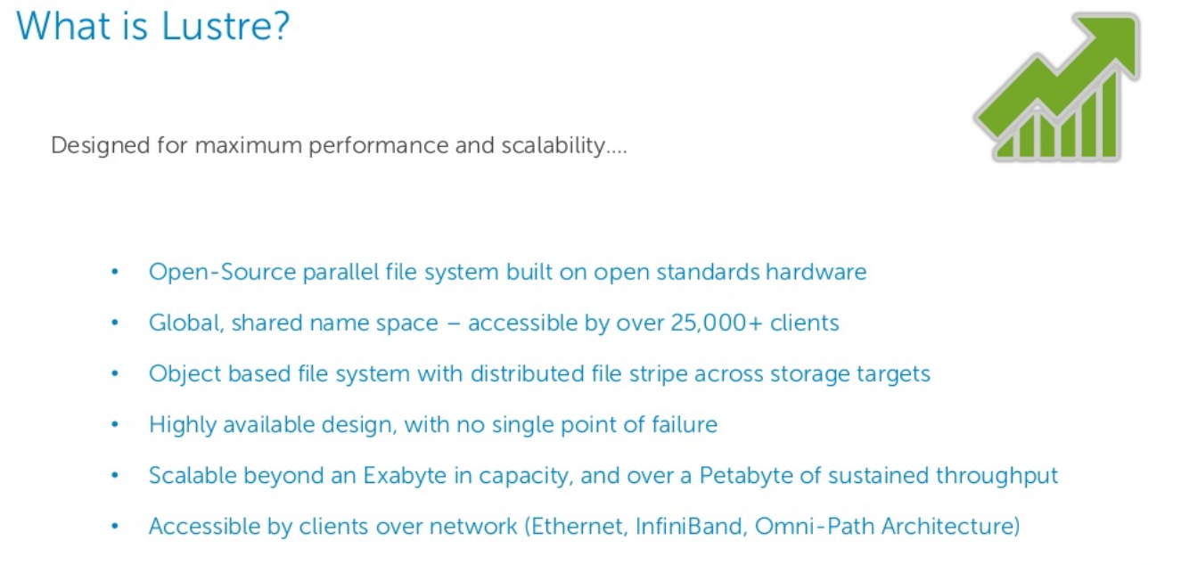

Slide 7
Components of the Lustre File System
Notes:
Section breaker slide
Used for a section heading. You may add a sub heading not exceeding one line also here
Section heading – Arial Headings, bold, 34 font size, should not exceed beyond 1 line
Sub Head – Arial Headings, normal, 18 font size, should not exceed beyond 1 line

Slide 8
Components
MDS (Metadata Server)
MDT (Metadata Target)
MGS (Management Server)
MGT (Management Target)
OSS (Object Storage Server)
OST (Object Storage Target)
LNET
Lustre Client
Notes:
Content Slide: This is usually the most frequently used slide in every presentation.
Use this slide for Text heavy slides. Text can only be used in bullet points
Title Heading – font size 30, Arial Heading
Slide Content – Should not reduce beyond Arial body font 16
If you need to use sub bullets please use the indent buttons located next to the bullets buttons in the tool bar and this will automatically provide you with the second, third, fourth & fifth level bullet styles and font sizes
Please note you can also press the tab key to create the different levels of bulleted content

Slide 9
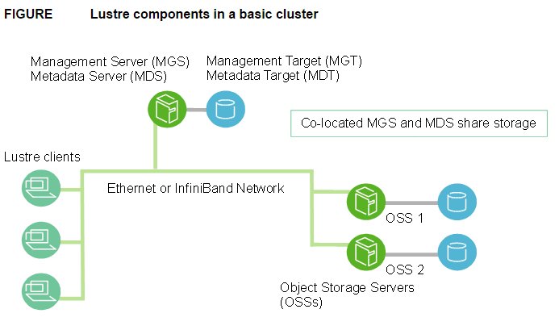
Count..

Slide 10
How Lustre Works
Notes:
Section breaker slide
Used for a section heading. You may add a sub heading not exceeding one line also here
Section heading – Arial Headings, bold, 34 font size, should not exceed beyond 1 line
Sub Head – Arial Headings, normal, 18 font size, should not exceed beyond 1 line

Slide 11
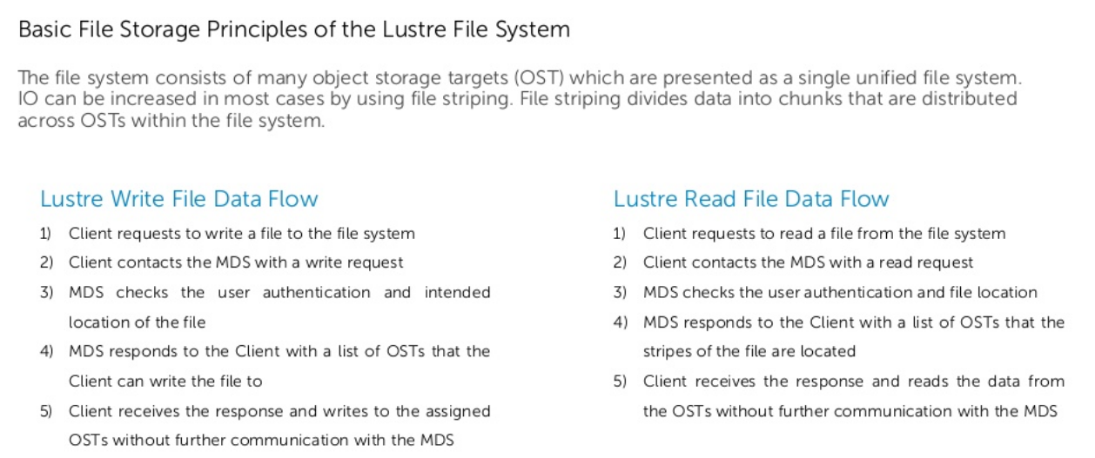
How Lustre Works
Notes:
Content Slide: This is usually the most frequently used slide in every presentation.
Use this slide for Text heavy slides. Text can only be used in bullet points
Title Heading – font size 30, Arial Heading
Slide Content – Should not reduce beyond Arial body font 16
If you need to use sub bullets please use the indent buttons located next to the bullets buttons in the tool bar and this will automatically provide you with the second, third, fourth & fifth level bullet styles and font sizes
Please note you can also press the tab key to create the different levels of bulleted content

Slide 12
Lustre Storage and I/O
In a Lustre file system, a file stored on the MDT points to one or more objects associated with a data file, as shown in next slide.
Each object contains data and is stored on an OST.
If the MDT file points to one object, all the file data is stored in that object.
If the file points to more than one object, the file data is “striped” across the objects (like RAID 0) and each object is stored on a different OST.
Each filename points to an inode.
The inode contains all of the file attributes, such as owner, access permissions, Lustre striping layout, access time, and access control.

Slide 13
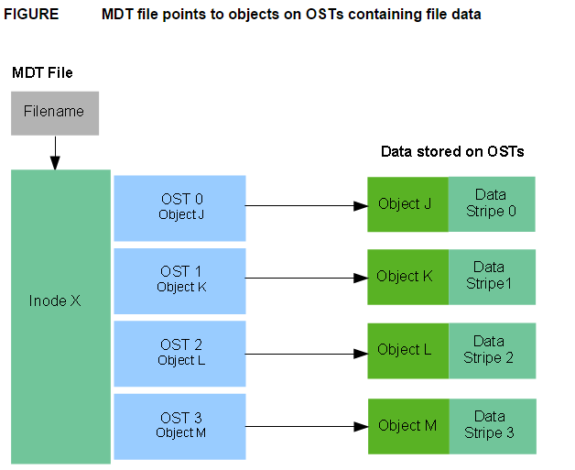
Diagram..

Slide 14
Lustre clients
Lustre clients are computational, visualization or desktop nodes that are running Lustre
client software, allowing them to mount the Lustre file system.
The Lustre client software provides an interface between the Linux virtual file system and the Lustre servers.
The client software includes :-
Management client (MGC),
Metadata client (MDC),
Multiple object storage clients (OSCs), one corresponding to each OST in the file system.
A logical object volume (LOV) aggregates the OSCs to provide transparent access across all the OSTs.
Thus, a client with the Lustre file system mounted sees a single, synchronized namespace.

Slide 15
File open and file I/O in Lustre
When a client opens a file, the File Open operation transfers the file layout from the MDS to the client.
The client then uses this information to perform I/O on the file, directly interacting with the OSS nodes where the objects are used.
Below diagram illustrates the operations

Slide 16
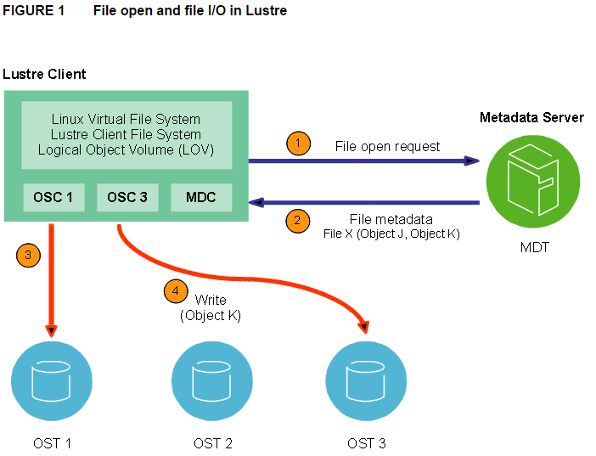
File open and file I/0 in lustre

Slide 17
Lustre File System and Striping
One of the main Factors leading to the high performance of the Lustre file system is the ability to stripe data across multiple OSTs in a round-robin fashion.
Users can optionally configure for each file number of strips, stripe Size, and OSTs are used.
The ability to stripe is also useful when a single OST does not have enough free space to hold an entire file
Striping allows segment or “chunks” of data in a file to be stored on different OSTs.
In Lustre file system, A RAID 0 pattern is used in which data is striped across a certain number of objects.
The number of objects in a single file is called the stripe_count

Slide 18
Count..
Each object contain a chuck of data from the file. When the chunk of data being written to a particular object exceeds the stripe_size. The next chunk of data in the file is stored on the next object.
Default value of stripe_count is 1.
Default value of Stripe_size is 1MB

Slide 19
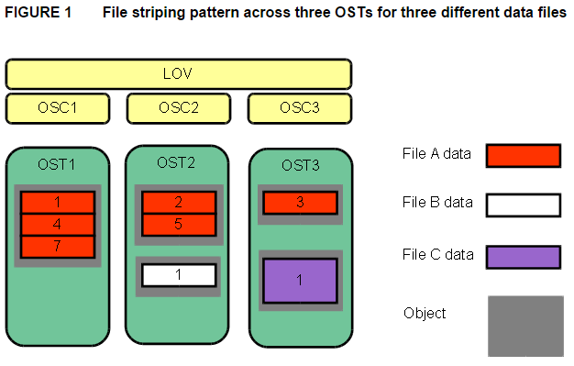
Striping..

Slide 20
Kernel Platform and Lustre versions
Notes:
Section breaker slide
Used for a section heading. You may add a sub heading not exceeding one line also here
Section heading – Arial Headings, bold, 34 font size, should not exceed beyond 1 line
Sub Head – Arial Headings, normal, 18 font size, should not exceed beyond 1 line

Slide 21
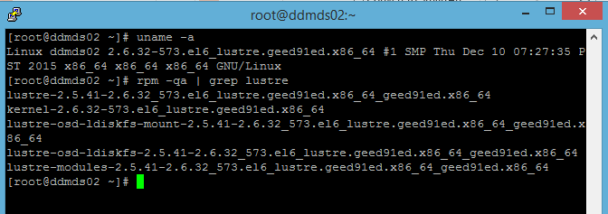
Server OS kernel and Lustre versions

Slide 22
Client kernel and Lustre versions
Notes:
Section breaker slide
Used for a section heading. You may add a sub heading not exceeding one line also here
Section heading – Arial Headings, bold, 34 font size, should not exceed beyond 1 line
Sub Head – Arial Headings, normal, 18 font size, should not exceed beyond 1 line

Slide 23
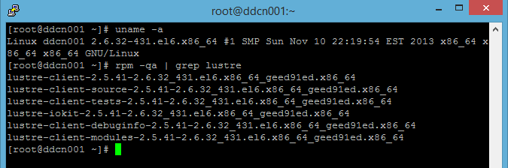
Client kernel and Lustre versions
Notes:
Content Slide: This is usually the most frequently used slide in every presentation.
Use this slide for Text heavy slides. Text can only be used in bullet points
Title Heading – font size 30, Arial Heading
Slide Content – Should not reduce beyond Arial body font 16
If you need to use sub bullets please use the indent buttons located next to the bullets buttons in the tool bar and this will automatically provide you with the second, third, fourth & fifth level bullet styles and font sizes
Please note you can also press the tab key to create the different levels of bulleted content

Slide 24
Introducing the Intel Enterprise Edition for Lustre
Notes:
Section breaker slide
Used for a section heading. You may add a sub heading not exceeding one line also here
Section heading – Arial Headings, bold, 34 font size, should not exceed beyond 1 line
Sub Head – Arial Headings, normal, 18 font size, should not exceed beyond 1 line

Slide 25
Introducing the Intel Enterprise Edition for Lustre
Intel® Enterprise Edition for Lustre* software, when integrated with Linux, aggregates a range of storage hardware into a single Lustre* file system.
Lustre* is a global, single-namespace file system architecture that allows parallel access by many clients to all the data in the file system across many servers and storage devices.
Designed to take advantage of the reliability features of enterprise-class storage hardware, Intel® EE for Lustre* software provides high availability features including redundant servers with storage failover.
Metadata and data are stored on separate servers to allow each system to be optimized for different workloads.
Notes:
Content Slide: This is usually the most frequently used slide in every presentation.
Use this slide for Text heavy slides. Text can only be used in bullet points
Title Heading – font size 30, Arial Heading
Slide Content – Should not reduce beyond Arial body font 16
If you need to use sub bullets please use the indent buttons located next to the bullets buttons in the tool bar and this will automatically provide you with the second, third, fourth & fifth level bullet styles and font sizes
Please note you can also press the tab key to create the different levels of bulleted content

Slide 26
What is Intel® Manager for Lustre* Software?
Notes:
Section breaker slide with customer logo
Section heading – Arial Headings, 34, Bold
Sub head – Arial Headings, 18, normal
Used for a section heading. You may add a sub heading not exceeding one line also here
Section heading – Arial Headings, bold, 34 font size, should not exceed beyond 1 line
Sub Head – Arial Headings, normal, 18 font size, should not exceed beyond 1 line

Slide 27
What is Intel® Manager for Lustre* Software?
The Intel® Manager for Lustre* software, which greatly simplifies configuring, creating, monitoring, and managing one or more Lustre file systems from either the manager GUI, or the associated command line interface (CLI).
Intel® Manager for Lustre* software is a part of the Intel® Enterprise Edition for Lustre* software product.
Notes:
Content Slide: This is usually the most frequently used slide in every presentation.
Use this slide for Text heavy slides. Text can only be used in bullet points
Title Heading – font size 30, Arial Heading
Slide Content – Should not reduce beyond Arial body font 16
If you need to use sub bullets please use the indent buttons located next to the bullets buttons in the tool bar and this will automatically provide you with the second, third, fourth & fifth level bullet styles and font sizes
Please note you can also press the tab key to create the different levels of bulleted content

Slide 28
What is Management Mode?
Notes:
Section breaker slide with customer logo
Section heading – Arial Headings, 34, Bold
Sub head – Arial Headings, 18, normal
Used for a section heading. You may add a sub heading not exceeding one line also here
Section heading – Arial Headings, bold, 34 font size, should not exceed beyond 1 line
Sub Head – Arial Headings, normal, 18 font size, should not exceed beyond 1 line

Slide 29
Management Mode
The Intel® Manager for Lustre* software lets you create and manage new high-availability (HA) Lustre file systems from its GUI.
For each HA file system, the GUI and dashboard let you create, monitor, and manage all servers and their respective targets.
The software lets you define failover servers to support HA.
To provide robust HA support, Intel® Manager for Lustre* software automatically configures Corosync and Pacemaker, and takes advantage of IPMI or PDUs to support server failover.
Notes:
Content Slide: This is usually the most frequently used slide in every presentation.
Use this slide for Text heavy slides. Text can only be used in bullet points
Title Heading – font size 30, Arial Heading
Slide Content – Should not reduce beyond Arial body font 16
If you need to use sub bullets please use the indent buttons located next to the bullets buttons in the tool bar and this will automatically provide you with the second, third, fourth & fifth level bullet styles and font sizes
Please note you can also press the tab key to create the different levels of bulleted content

Slide 30
What is Monitor-only Mode?
Notes:
Section breaker slide with customer logo
Section heading – Arial Headings, 34, Bold
Sub head – Arial Headings, 18, normal
Used for a section heading. You may add a sub heading not exceeding one line also here
Section heading – Arial Headings, bold, 34 font size, should not exceed beyond 1 line
Sub Head – Arial Headings, normal, 18 font size, should not exceed beyond 1 line

Slide 31
What is Monitor-only Mode?
Monitor-only mode allows you to “discover” a working Lustre file system. Using Intel® Manager for Lustre* software, you can then monitor the file system at the Intel® Manager for Lustre* dashboard. All of the charts presented on the manager dashboard to monitor performance and statistics, are also available in monitor-only mode.

Slide 32
Overall System Configuration
Notes:
Section breaker slide with customer logo
Section heading – Arial Headings, 34, Bold
Sub head – Arial Headings, 18, normal
Used for a section heading. You may add a sub heading not exceeding one line also here
Section heading – Arial Headings, bold, 34 font size, should not exceed beyond 1 line
Sub Head – Arial Headings, normal, 18 font size, should not exceed beyond 1 line

Slide 33
Overall System Configuration
The high-level configuration of an HA file system managed by Intel® EE for Lustre* software consists of the following:
A dedicated manager server hosts the Intel® Manager for Lustre software and dashboard.
We have IML
Management server (MGS): The MGS provides access to the management target (MGT) storage. To support failover, the management server is also configured as the backup for the metadata server.
We have mgs (Primary for MGT) and (Secondary for MDT)

Slide 34
Count..
Metadata server (MDS): The MDS provides access to the metadata target storage. To support failover, the metadata server is also configured as the backup management server.

Slide 35
Count..
Object storage server (OSS): At least two servers provide access to the object storage targets, which store the file system’s data. OSSs are configured in failover pairs sharing access to the same data storage, so that if an OSS fails, service is automatically failed over to its peer server.

Slide 36
Count….
Management target (MGT): The MGT stores configuration information for all the Lustre file systems in a cluster and provides this information to other Lustre components.
The MGT is accessed by the primary MGS and, if the MGS fails, by the MDS operating in failover mode. The MGT should not be larger than 10 Gbyte in capacity.
Metadata target (MDT): The MDT stores metadata (such as file names, directories, permissions, and file layout) for attached storage and makes them available to clients. The MDT is accessed by the primary MDS and, if the MDS fails, by the MGS operating in failover mode.

Slide 37
Count…
Object storage targets (OSTs): Client file system data is stored in one or more objects that are located on separate OSTs.
The number of objects per file is configurable by the user and can be tuned to optimize performance for a given workload.
RAID 6 is recommended for OSTs.
RAID is implemented independent of Intel® Manager for Lustre* software.

Slide 38
Count..
Management network - The Management network is gigabit Ethernet, connecting every server in the file system.
This network is used with ssh, to install and update Intel® Manager for Lustre* software on each server.
It is also used to manage the servers and make separate connections to an IPMI port installed on each managed server.

Slide 39
Count..
Lustre network – Generally the Lustre network (LNET) is either 10-gigabit Ethernet or InfiniBand and provides high-speed file system access for each client.

Slide 40
Possible Server Requirements
Notes:
Section breaker slide with customer logo
Section heading – Arial Headings, 34, Bold
Sub head – Arial Headings, 18, normal
Used for a section heading. You may add a sub heading not exceeding one line also here
Section heading – Arial Headings, bold, 34 font size, should not exceed beyond 1 line
Sub Head – Arial Headings, normal, 18 font size, should not exceed beyond 1 line

Slide 41
Manager Server Requirements
The manager server is a dedicated server on which the Intel® Manager for Lustre* software is installed. This is unique from the management server. Requirements for the manager server are listed next.
X86 CPU
At least 4 GB of RAM
Storage on the server large enough to accommodate: 24 GB for the operating system and additional packages
Swap space equal to twice the available RAM present
Base OS installation that provides at least a 500-GB /var partition

Slide 42
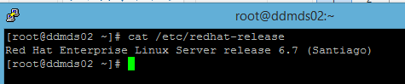
Count..
A one gigabit Ethernet port to connect to the management network.
RAID 1 is a minimum recommendation. RAID 10 may be optimal for heavy workloads.
Red Hat Enterprise Linux or CentOS Linux, version 6.7, must be installed.
All Lustre servers should be running the same OS and version.

Slide 43
Count..
yum needs to be functional and default yum repositories must be fully configured. Run yum update to verify that yum updates occur successfully.
Intel® Manager for Lustre* software is supported on:
Latest released Google Chrome browser.
Latest released Mozilla Foundation Firefox browser.

Slide 44
Management Server and Metadata Server Requirements
The management server (MGS) is configured as a failover server with the metadata server (MDS), and vice-versa, so the MGS and MDS share the same configuration requirements.
Note: The MGS is separate from the independent server running Intel® Manager for Lustre* software.

Slide 45
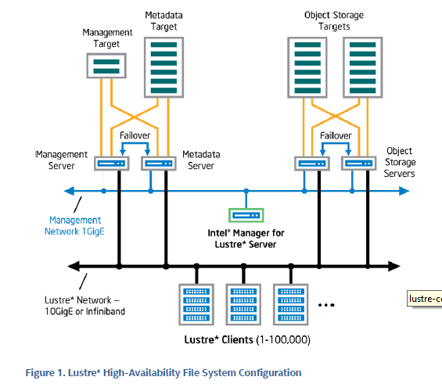
Block Diagram..

Slide 46
Count..
The MDS and MGS, both independent servers, share the following requirements.
X86 CPU
MDS and MGS memory requirements are determined by factors such as the number of clients, the sizes of directories, and the load placed on the server.
Red Hat Enterprise Linux or CentOS Linux version 6.7 must be installed. All Lustre servers should be running the same OS and version.

Slide 47
Count..
A dedicated Ethernet port capable of one gigabit/sec. This port connects to the Management network.
• yum needs to be functional, with any needed proxies, and default yum repositories must be fully configured. Run yum update to verify that yum updates occur successfully.
• HA servers are configured in pairs, with a primary server and a failover server.

Slide 48
Count..
Crossover cable – Each HA server (excluding the manager server) is connected to its peer HA server by a private crossover link. This is an Ethernet connection.
All required multipath configuration between each storage server controller and its physical storage devices must be complete.
Storage controllers and drives must already be installed and LUNs must already be configured and present.
Each server of a failover pair must have access to exactly the same LUNs as its peer. Each LUN is visible only to its two, paired failover servers.

Slide 49
Management Target
For comparatively small file systems, the typical management target capacity might be 100MB.
Intel® Manager for Lustre software does not support an MGT larger than 10 Gbytes.
RAID 1 is recommended.
As described above, the MGS and MDS servers are connected to the management storage in a primary/failover configuration.
All required multipath configuration between each storage server controller and its physical storage devices must be complete.

Slide 50
Metadata Target
Storage capacity for the metadata target should be 2K bytes per storage system file. Multiply the anticipated number of files the file system will contain by 2K to determine the required capacity of the target.
RAID 10 is recommended for metadata targets.
As described above, the MGS and MDS servers are connected to metadata storage in a primary/failover configuration.
All required multipath configuration between each storage server controller and its physical storage devices must be complete.

Slide 51
Object Storage Server and Target Requirements
The object storage server (OSS) provides access to the object storage target(s) (OST). There is no specific limit to the number of OSSs. For HA, each OSS must have a failover twin. This means that OSSs are paired.
The maximum capacity for an OST is 128 terabytes. Figure below slide depicts the configuration and interconnect requirements for HA OSSs and OSTs.

Slide 52
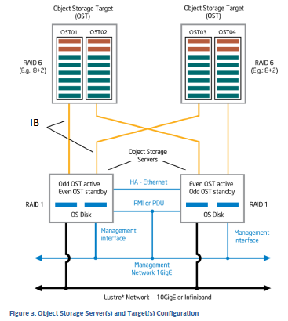
Count..
OST

Slide 53
Count..
Requirements for HA object storage servers and targets are as follows:
Red Hat Enterprise Linux or CentOS Linux version 6.7 must be installed.

Slide 54
Count..
Any required multipath configuration between each storage server controller and its physical storage devices must be complete.
Storage controllers and drives must already be installed and LUNs must already be configured and present.
Each server of a failover pair must have access to exactly the same LUNs as its peer. Each LUN is visible only to its two, paired failover servers.

Slide 55
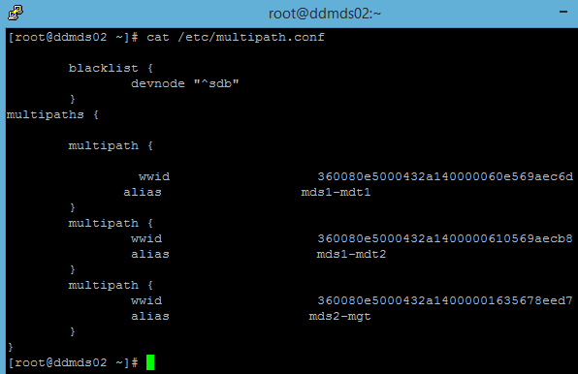
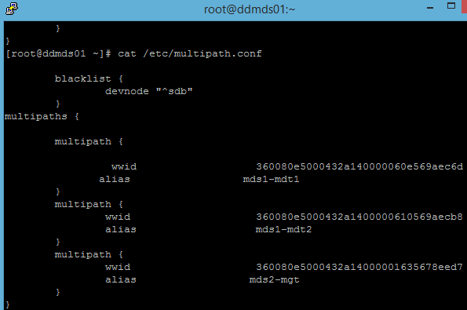
/etc/Multipath.conf file

Slide 56
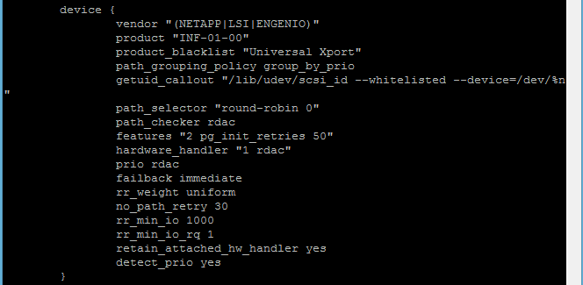
Device Configuration in Multipath.conf

Slide 57
Count..
For proper failover functionality, paired servers must be able to access the other’s power control device.
This can be implemented using power distribution units (PDUs) or by using IPMI.

Slide 58
Power Control to Support Failover
High availability requires the ability to shut down a failing server so that it will not interfere with file system operations, allowing the backup (failover) server to assume its role.
This control can be provided by using power distribution units (PDUs) or IPMI.
To comply with this High Availability Configuration Specification, you must use either PDU control or IPMI, but not both.

Slide 59
Pre-Installation Tasks
What Not to Do
Please do not perform the following tasks, as these tasks (among others) are performed automatically, or will conflict with the software:
Do not configure IP addresses for the crossover cable interfaces (server to target).
Do not install or configure Lustre, Corosync, or Pacemaker.
Do not configure NTP on storage servers.
When installing Red Hat Enterprise Linux or CentOS Linux, do not use the EPEL repositories. Uninstall EPEL-release on all systems if it is installed.
Do not install CMAN (Cluster Manager) or other packages that use the Red Hat fence agents. Intel® Manager for Lustre* software will have package conflicts. Remove all such packages from all systems.

Slide 60
LNET Configuration
LNET provides the client network infrastructure required by the Lustre file system. It supports many commonly-used network types such as InfiniBand and Ethernet.
Basic LNET configuration can be performed using the Intel® Manager for Lustre GUI. This is done before creating the Lustre file system.
The configuration information is saved in a reserved file called /etc/modprobe.d/iml_lnet_module_parameters.conf.
Do not manually edit this file.

Slide 61
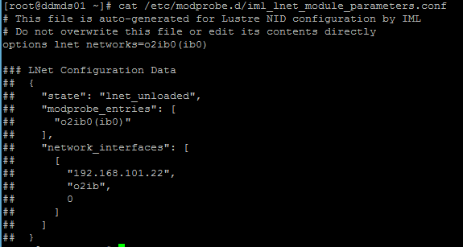
Lnet Configuring File

Slide 62
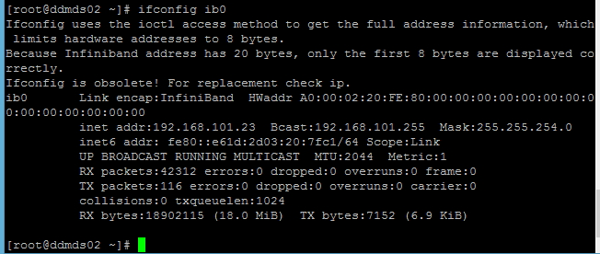
Configuring ib0 Interface for lnet

Slide 63

Checking LNET

Slide 64
Server Configuration
The following are pre-installation configuration requirements for servers. These requirements apply to ALL servers unless specifically noted.
Red Hat Enterprise Linux or CentOS Linux version 6.7 must be installed. All servers should be running the same OS and version.
Do not use the EPEL repositories. Uninstall EPEL-release on all systems if it is installed.
Next, you will need to configure hostname resolution of all Lustre nodes, on each Lustre node.
Dynamic hostname resolution (DNS) can be used to perform this step.
If DNS is not being used, you can perform this manually as follows:
Set useful hostnames and ensure you have a functioning /etc/hosts file. Give each server a unique name, such as manager, mds1, mds2, oss1 and oss2.
You should be able to “ping <hostname>” and ssh freely between systems (dependent on a functional /etc/hosts file).

Slide 65
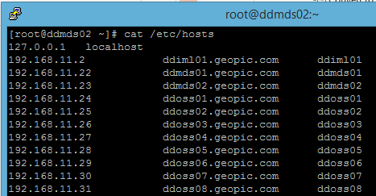

Slide 66
Count..
Copy your /etc/hosts file to all servers.
Use ssh-copy-id to copy your ssh public key to each server so that your servers are able to ssh into each other without having to enter a password.

Slide 67
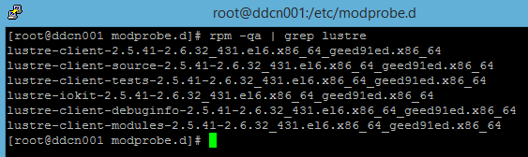
Client Requirements
Make sure all compiled lustre client rpm’s are installed
Lustre must be compiled over the client kernel and ofed modules.

Slide 68
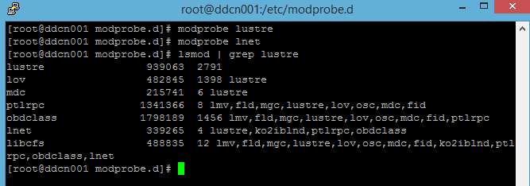
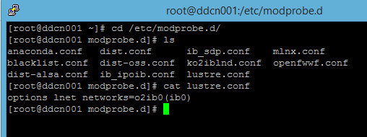
Client Requirements
Make sure lustre and lnet modules are loded
LNET provides the client network infrastructure required by the Lustre file system and LNET must be configured for each client.

Slide 69
Installing Intel® EE for Lustre* software
You will need the following information to perform this installation:
The name, email address, and password you wish to use for the first Intel® Manager for Lustre* software superuser. The email address must use an FQDN.
(Optional) The fully qualified domain name (FQDN) of the NTP server (internal or external) used for your site. If no NTP server is set, the Intel® Manager for Lustre* server's clock will act as the time source for the entire storage cluster.

Slide 70
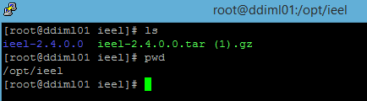
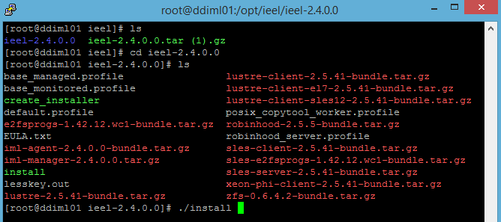
To install the software, complete these steps:
Download the installation archive to a directory on the manager server (e.g. /opt/ieel).
Unpack the installation archive using tar: ieel-2.4.0.0.tar.gz

Slide 71
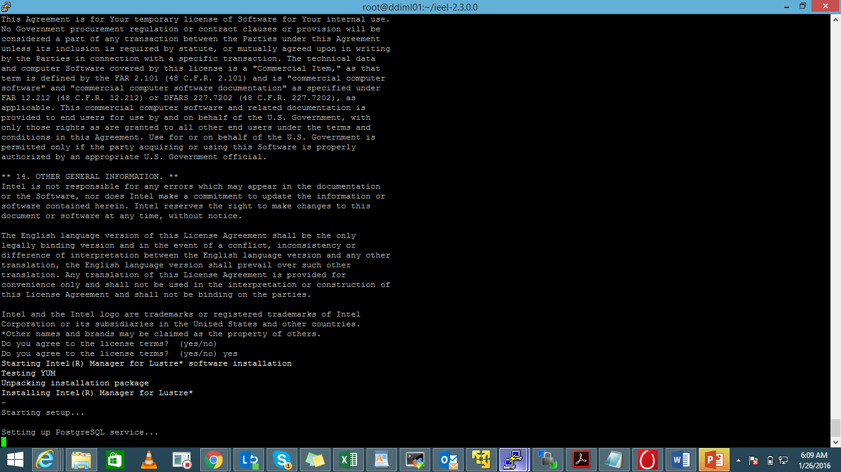
Installing ieel from Source Code..

Slide 72
Count..
When the prompts below appear, enter your parameters for the first superuser of Intel® Manager for Lustre*:
Username: <Enter the name of the superuser>
Email: <Enter an email address for the superuser>
Password: <Enter a password>
Confirm password: <Enter the password again>
Note: Additional Intel® Manager for Lustre* software superusers as well as file system administrators and users can be created in the manager GUI.
When configuration is complete, a message is displayed indicating the installation was successful.
When the prompt NTP Server [localhost] appears, respond with one of these options:

Slide 73
To install the Intel® EE for Lustre* software,
Using ifconfig, obtain the IP address of the administrative network interface for the server hosting Intel® Manager for Lustre* software. The default network interface for Intel® Manager for Lustre* software is eth0.
Open a web browser and access the Intel® Manager for Lustre* software GUI using the server IP address obtained in the previous step. Enter in the address field of your browser:
https://<command_center_server_IP_address>/
Note: If the IP address of the server has an associated FQDN, you can connect to the Intel® Manager for Lustre* GUI user interface using:
https://< command_center_server_fqdn>/
Note: The GUI uses a self-signed SSL certificate to secure communications between the browser and the server. You will need to accept this certificate in order to connect to the Intel® Manager for Lustre* GUI. A certificate can be downloaded from: https://<manager-addr>/certificate/
After Intel® EE for Lustre* is installed, point your web browser to the Intel® Manager for Lustre dashboard. Use Chrome* or Firefox*.

Slide 74
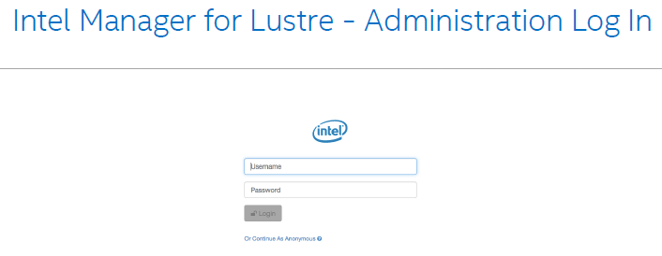
Intel Manager for Lustre-Admin login

Slide 75
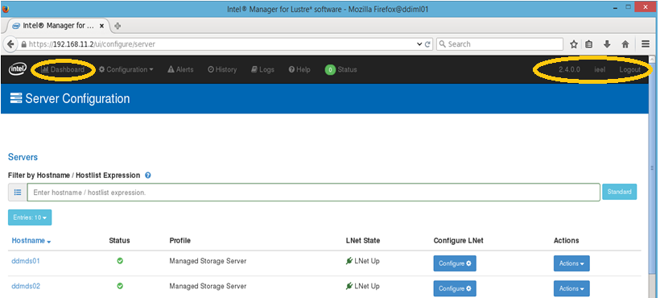
Intel Manager for Luster - dashboard

Slide 76
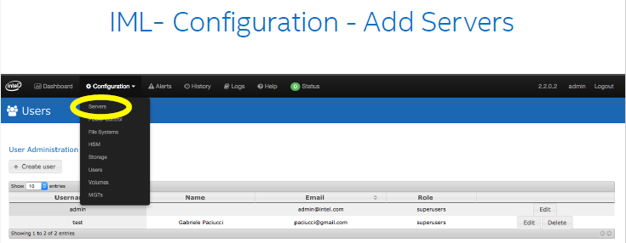

Slide 77
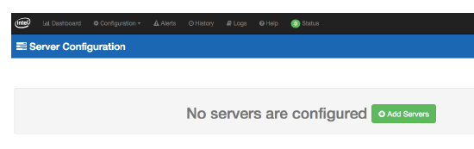
IML-Configuration – Add Servers

Slide 78
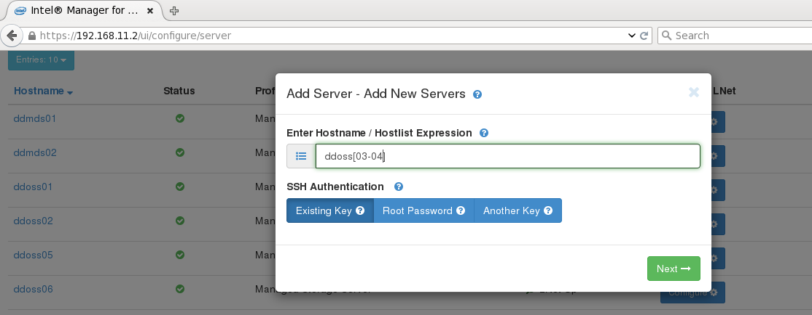
Add server

Slide 79
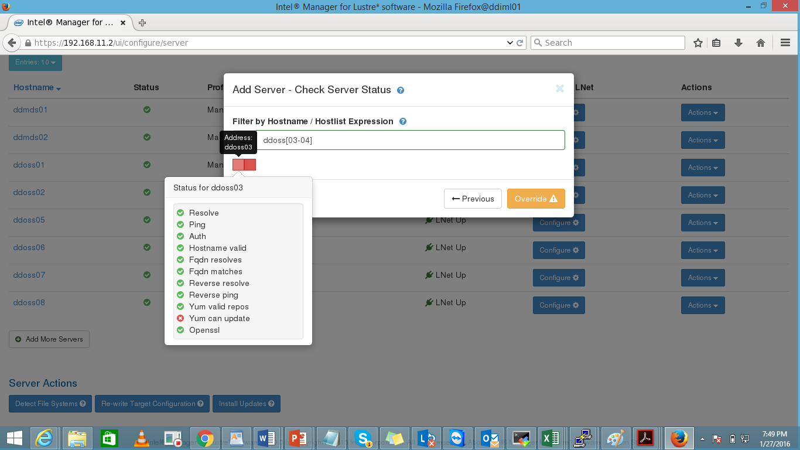

Slide 80
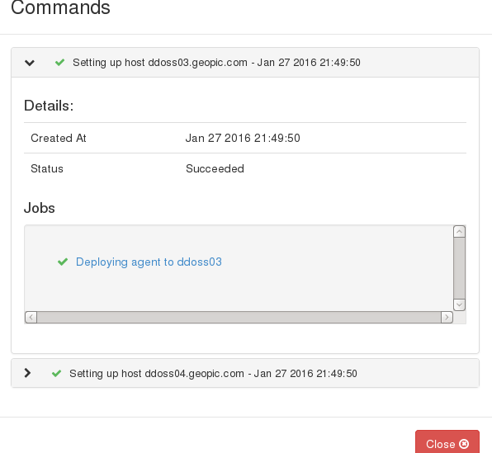

Slide 81
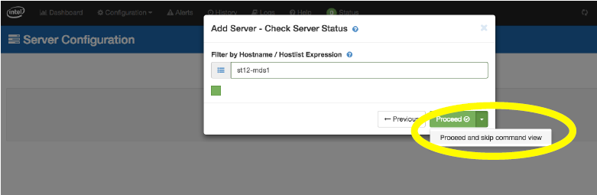

Slide 82
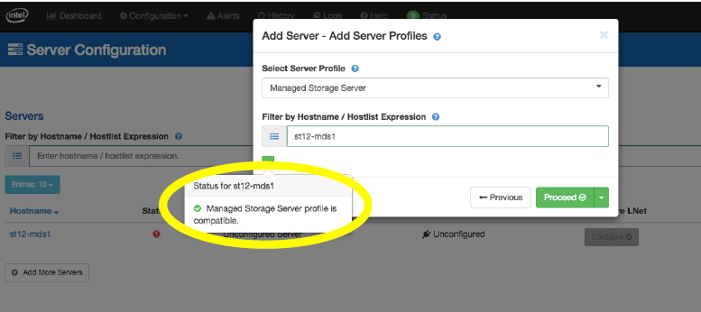

Slide 83
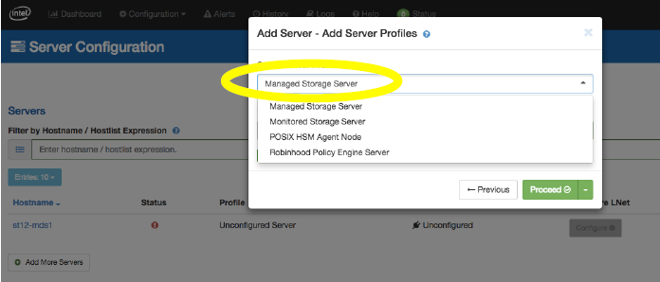

Slide 84
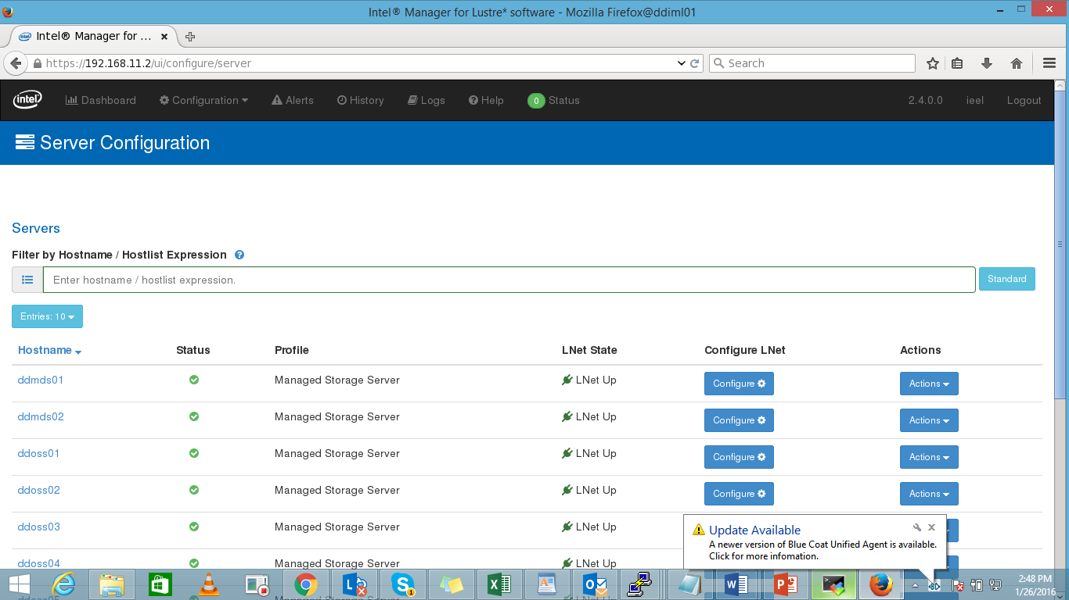

Slide 85
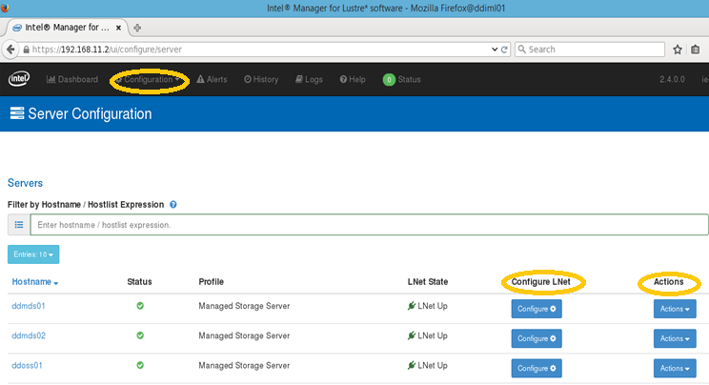
Configuring Lnet

Slide 86
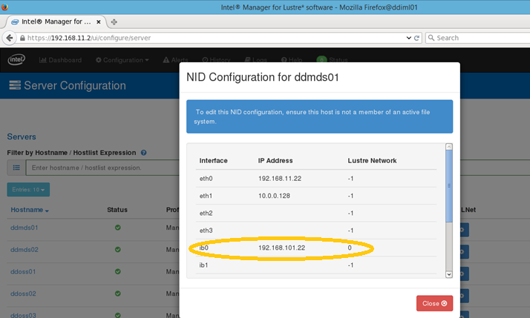
NID Configuration

Slide 87
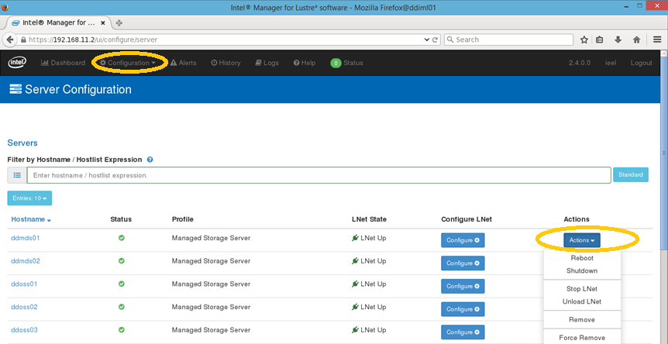
Action

Slide 88
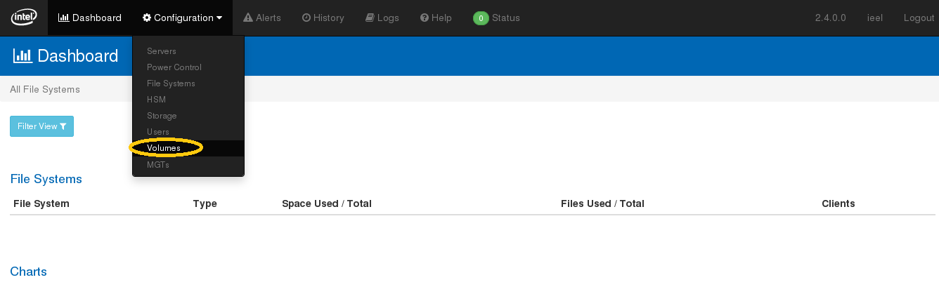
Configuring Volume

Slide 89
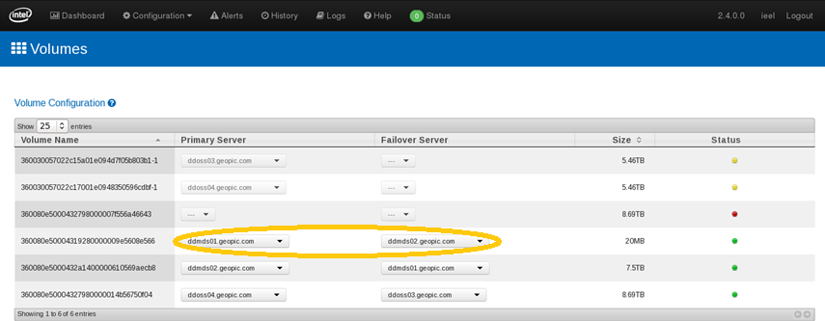
Primary & Failover Server for Volume

Slide 90
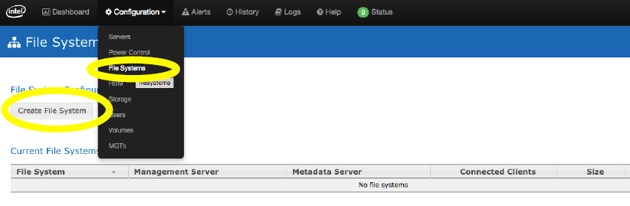
Create File System

Slide 91
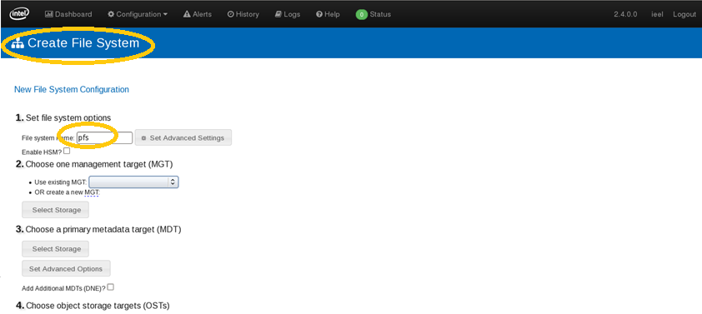
Create File System

Slide 92
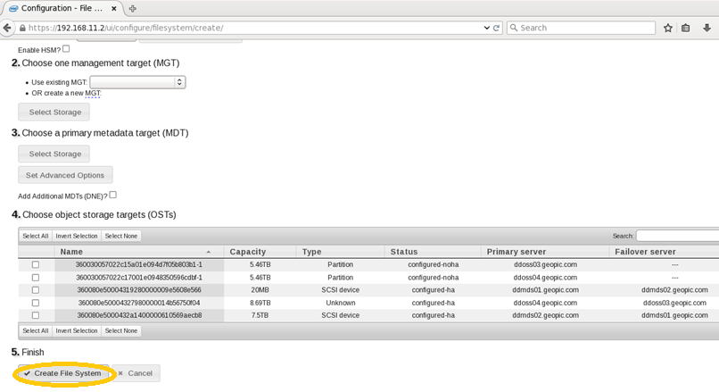
Create File System

Slide 93
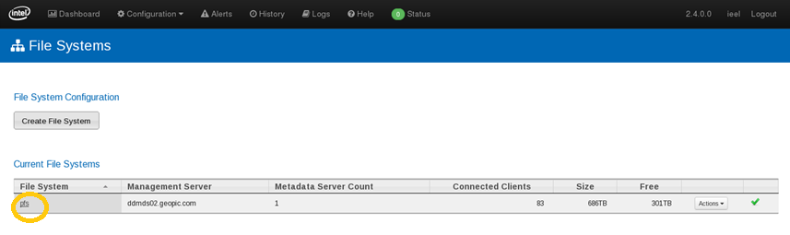
Current File System

Slide 94
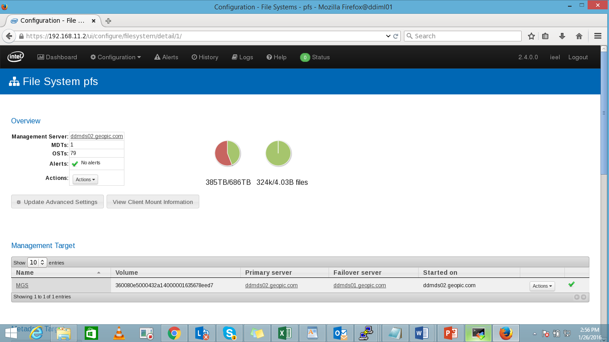

Slide 95
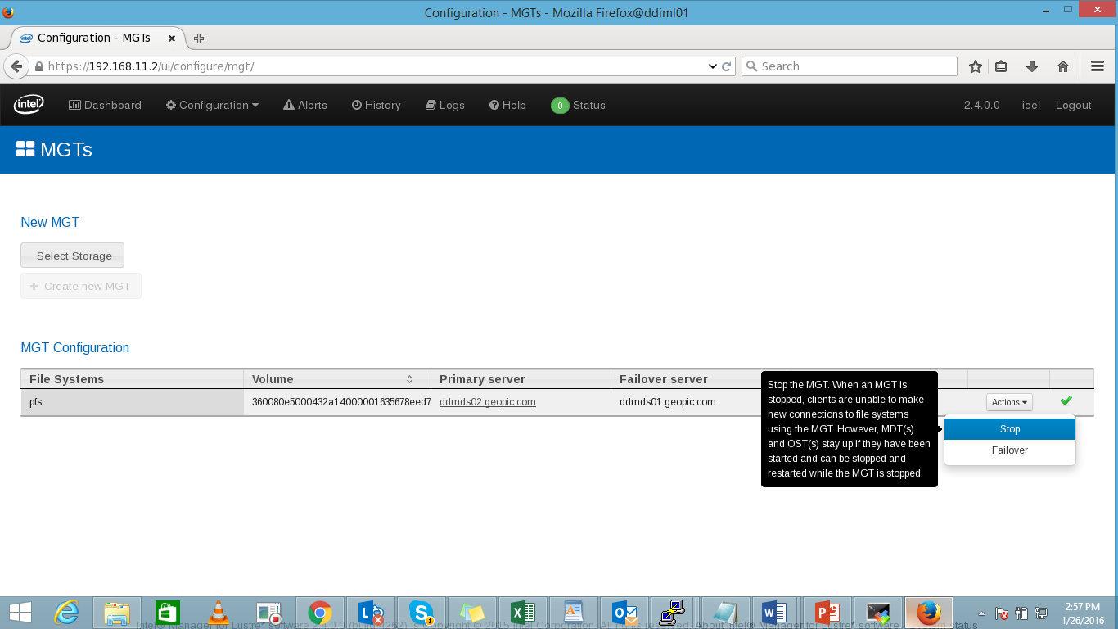
Stopping File System

Slide 96
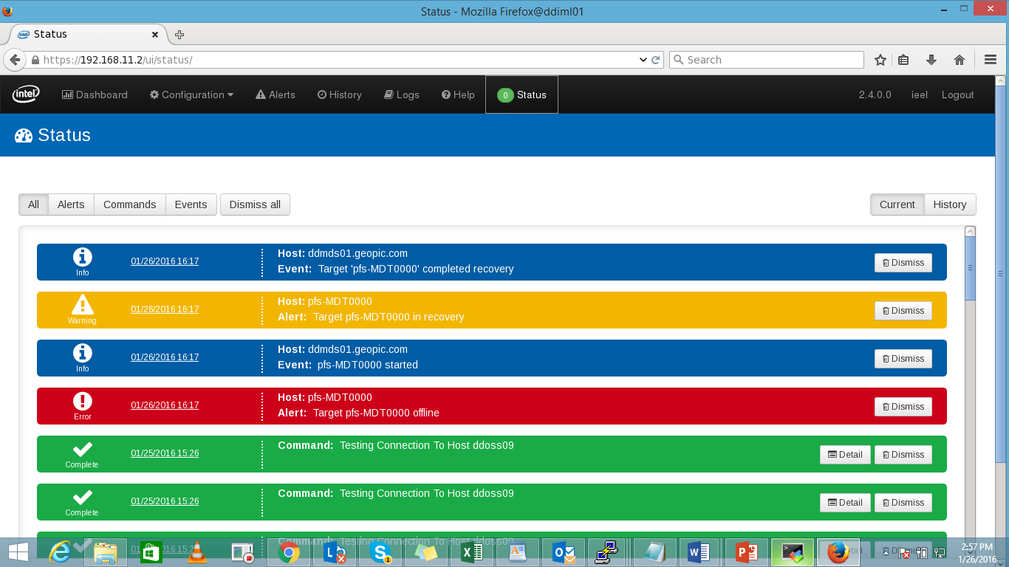
Status Tab

Slide 97
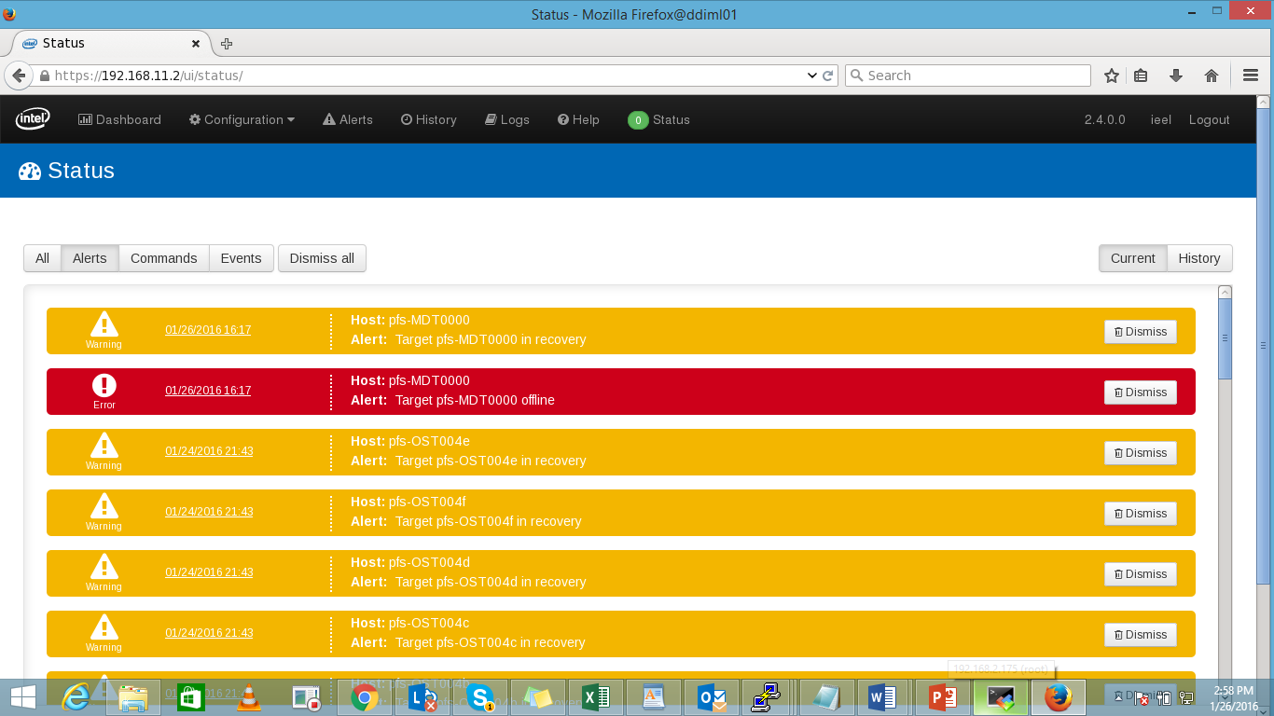
Status -> Alerts

Slide 98
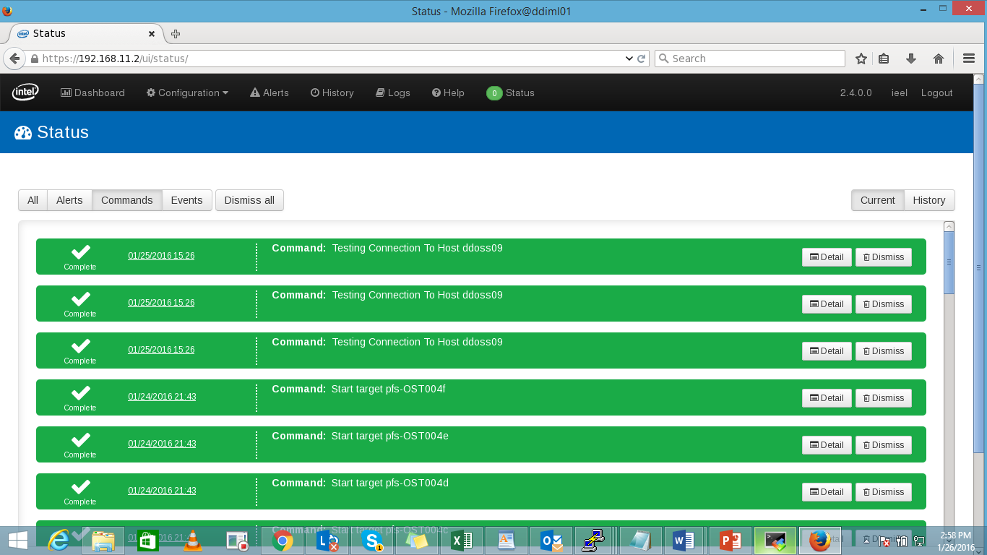
Status -> Commands

Slide 99
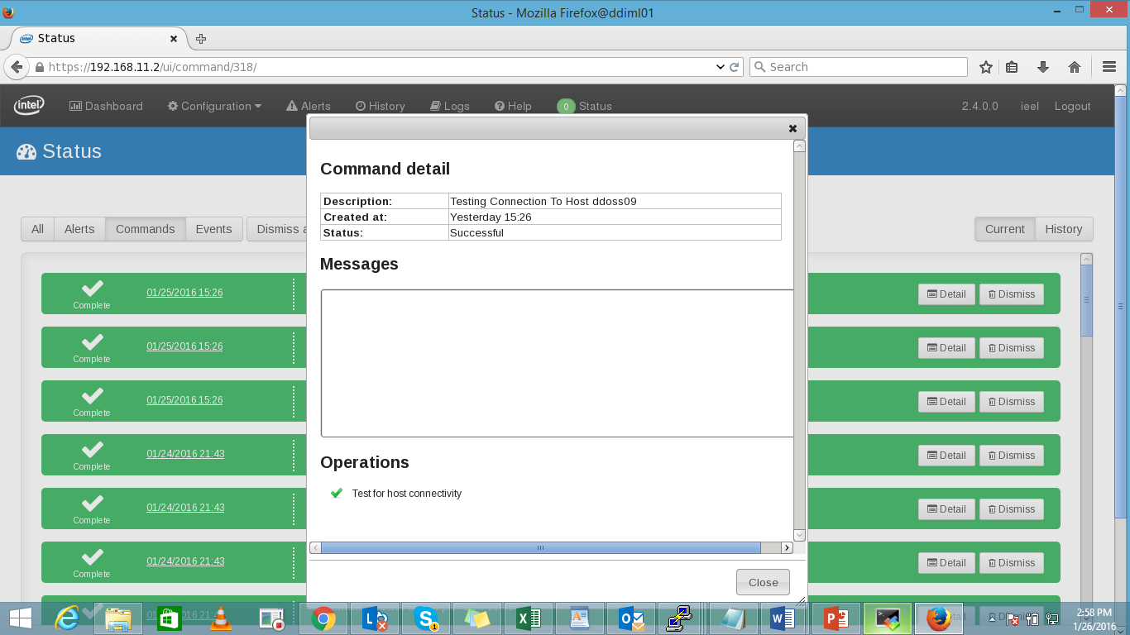
Status -> Command details

Slide 100
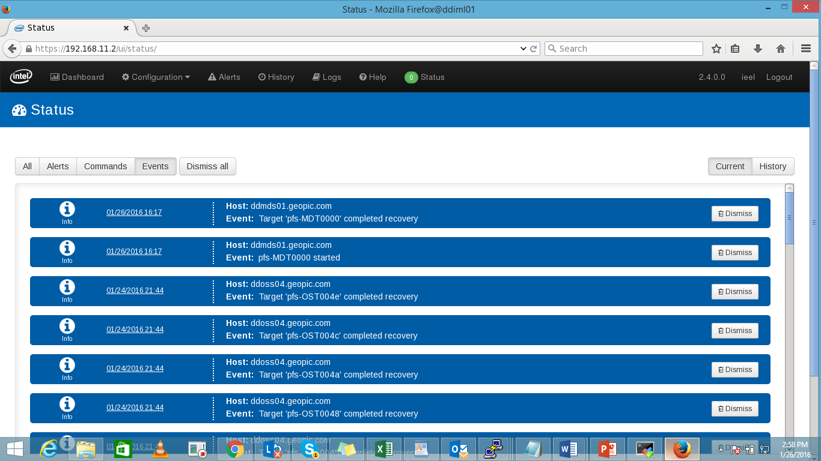
Status -> Events

Slide 101

Status -> Dismiss

Slide 102

Alert Tab

Slide 103

History Tab

Slide 104

Logs Tab

Slide 105

Starting and stopping lustre

Slide 106
Thank You
Nitin Pawar
Notes:
Section breaker slide with customer logo
Section heading – Arial Headings, 34, Bold
Sub head – Arial Headings, 18, normal
Used for a section heading. You may add a sub heading not exceeding one line also here
Section heading – Arial Headings, bold, 34 font size, should not exceed beyond 1 line
Sub Head – Arial Headings, normal, 18 font size, should not exceed beyond 1 line

